Slide 1
Getting Your DB Schema Under Control With SSDT
Peter A. Schott

Slide 2

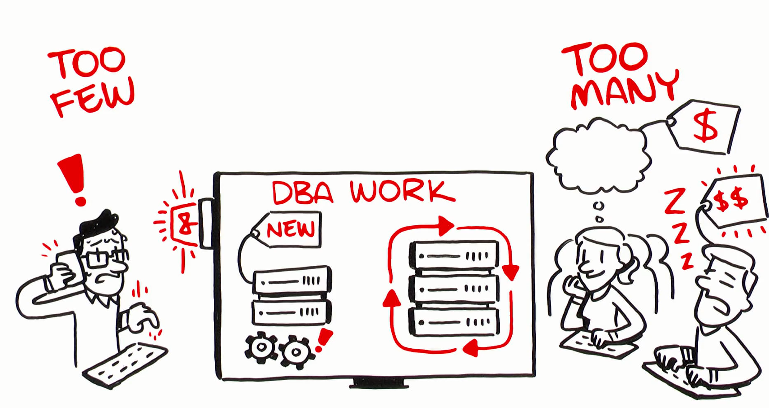






Our Niche
“We provide senior level DBAs to support to our customers for maximum flexibility in a model that aligns costs with usage.”
Service Features
Experienced, Assigned DBAs
100% U.S. Citizens
Direct Contact with DBAs
24x7 Incident Response
Integrated operational monitoring (optional)
Performance monitoring/assessment (optional)
Weekly Activity/Usage Reports
Service Benefits
Scalable DBA extension to team
No hiring or training costs
Pay-for-use model

Slide 3
Intro to SSDT
What is SSDT?
Brief history
Why would you use it?
SSIS
SSAS
SSRS
Databases
Notes:
VS DB Projects – large files, long build/compare times
SSDT – split into SSDT (DB Projects) and SSDT-BI – lots of confusion. BI Projects were version-specific
Current SSDT release – DB Projects, SSIS, SSAS, SSRS – can handle multiple (modern) SQL Versions
This presentation – DB Projects. Why? To get control of your schema in files that can go into source control.

Slide 4
Installing SSDT
Official source – Microsoft SSDT or VS
Use “Chocolatey”
Don’t need VS installed – will install a VS shell or Community Edition
Only install components/extensions you need/use
DB Projects installed by default
DB Projects also included in full Visual Studio 2015+ installs
Notes:
https://docs.microsoft.com/en-us/sql/ssdt/download-sql-server-data-tools-ssdt
Or use Chocolately to install VS shell + ssdt.
choco install visualstudio2019community
choco install visualstudio2019-workload-databuildtools --package-parameters "--no-includeRecommended"

Slide 5
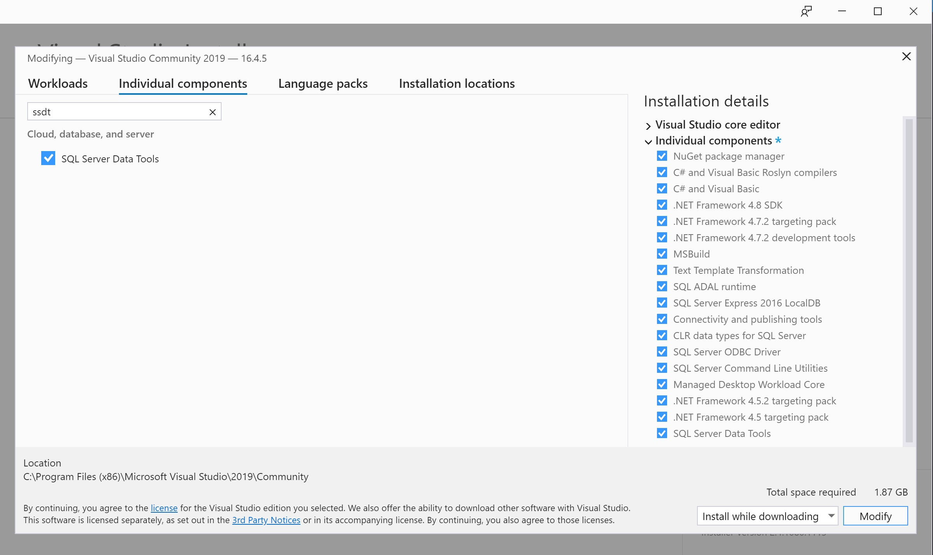
Visual Studio 2019
Visual Studio 2019 started using Extensions. Modify your install to add SSDT
Notes:
choco install visualstudio2019-workload-databuildtools --package-parameters "--no-includeRecommended“

Slide 6
Demo Time!
Notes:
Create empty project
Observe how sparse the project looks – no guidance
Import “AdventureWorks2012” – full import only works on empty/new project. Afterwards can only import scripts.
Usually avoid importing logins, users, and permissions – those tend to be environment-specific
Explore project – properties, object scripts (all CREATE), folders by schema/type
Show empty project with “Template” – folders and structures I’ve found helpful

Slide 7
Common Errors and Issues After Import
3-Part DB Names (current database)
Cross-database views/functions/procs
Linked Server references
Users/Logins not often the same in all environments
Notes:
See next slides

Slide 8
Dealing with 3-Part DB Names – Current DB
SSDT doesn’t know the current database name
Find/Replace is your friend
Limit to *.sql files
Variations
DBName.dbo.
DBName..
[DBName].[dbo].
etc.

Slide 9
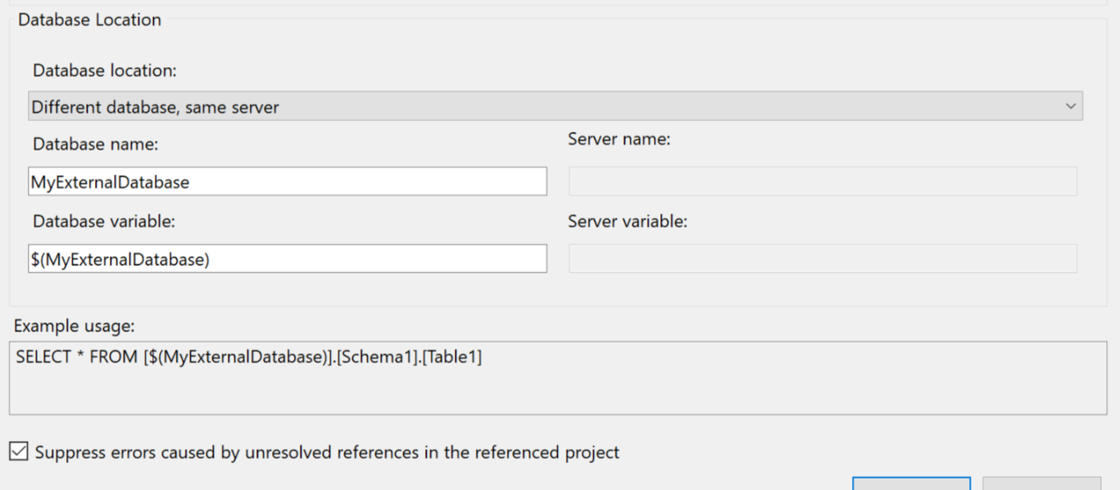
Cross-Database Objects
Database References
Use a common storage location
May need to use SQLPackage to extract a dacpac
Watch your variable settings!
Notes:
Sometimes the import just doesn’t work.
Leave variable blank if DB name will always be the same
Choose “Different Database, Different Server” for linked server dbs
https://msdn.microsoft.com/en-us/library/hh550080(v=VS.103).aspx

Slide 10
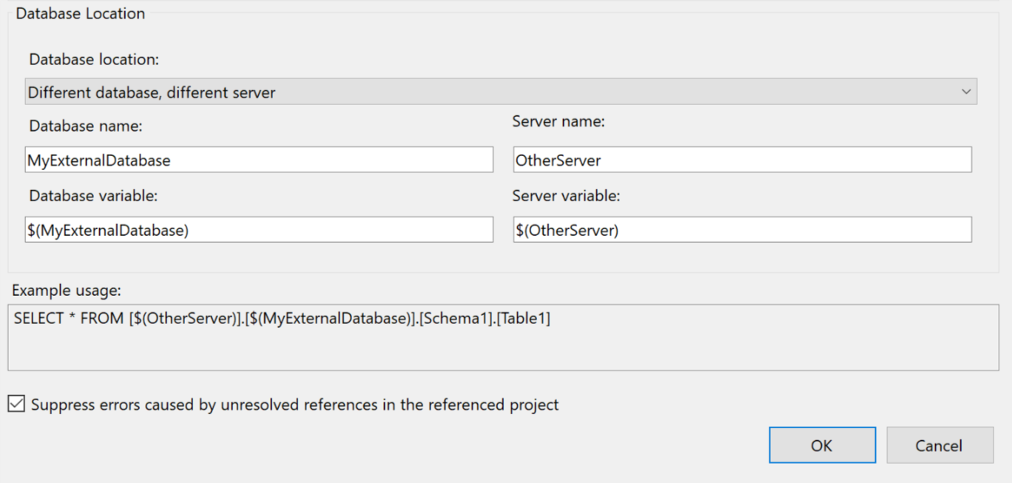
Linked Servers
Similar to Cross-Database objects
Set your options and variables appropriately
Doesn’t seem to work w/ OPENQUERY

Slide 11
Users/Logins
Easiest to ignore initially
Use DB Roles
Import puts these in the “Security” folder
If you really need this, there are ways…
https://schottsql.wordpress.com/2013/05/14/ssdt-setting-different-permissions-per-environment/
Kudos to Jamie Thomson for the idea

Slide 12
Back to the Project!
Notes:
Build/Publish
Deploy/Publish profiles to save options
Adding new objects/changing existing ones
Remember to check “Ignored” scripts
Pre/Post scripts
Snapshots
VCS – git, TFS, SVN, etc
Command-Line w/ demos

Slide 13
Potential Gotchas
Large numbers of objects
External databases
Users and Permissions
Rollbacks
SQL Server-only features such as FileStream

Slide 14
Where to Get Help
Stack Overflow:
https://stackoverflow.com/questions/tagged/ssdt
MS Forums:
https://social.msdn.microsoft.com/Forums/sqlserver/en-US/home?forum=ssdt&forum=ssdt
SQL Community Slack:
https://sqlps.io/slack/

Slide 15
Questions?
Peter Schott | @paschott
paschott@outlook.com
http://schottsql.com
Files:
https://github.com/paschott/SSDT_101
Rate this presentation:

